Slide 1
Segmenting Consumers of Bath Soap
Larisa Leverich

Slide 2
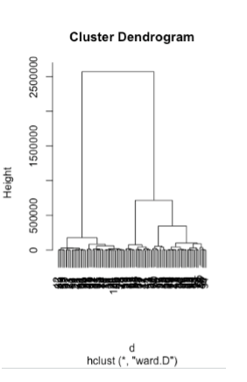
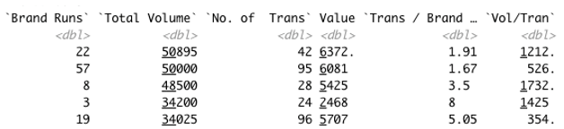
1. Reframing the problem
Through the data analysis, I focused on 3 different aspects that would indicate which cluster of households are more likely to be loyal customers. These were: variables that describe the purchase behavior, variables that describe the basis for purchase, and variables that account for both behavior and basis.
CRISA’s approach to segment the market based both aspects may be misguided, since the volume and price do not seem to be the leading factors behind a given purchase.
Rather, through data analysis in R Studio and data review, a more cost-effective promotion would involve factors such as age group, sex and affluence index. These segments will be discussed in the next slides.
The data was split into 3 clusters, while using Ward’s method for hierarchical clustering.

Slide 3
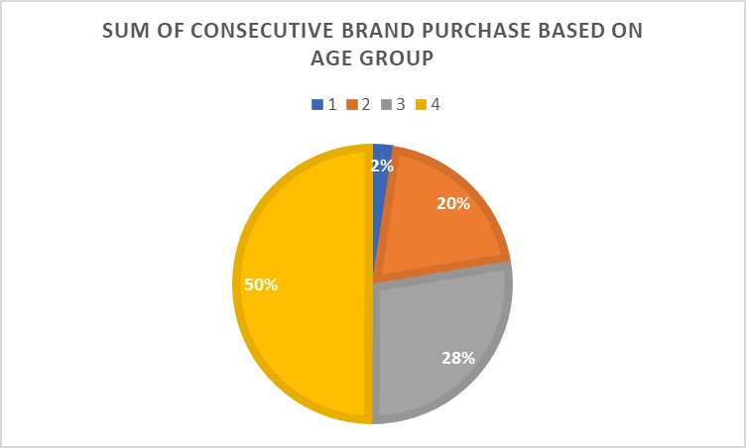
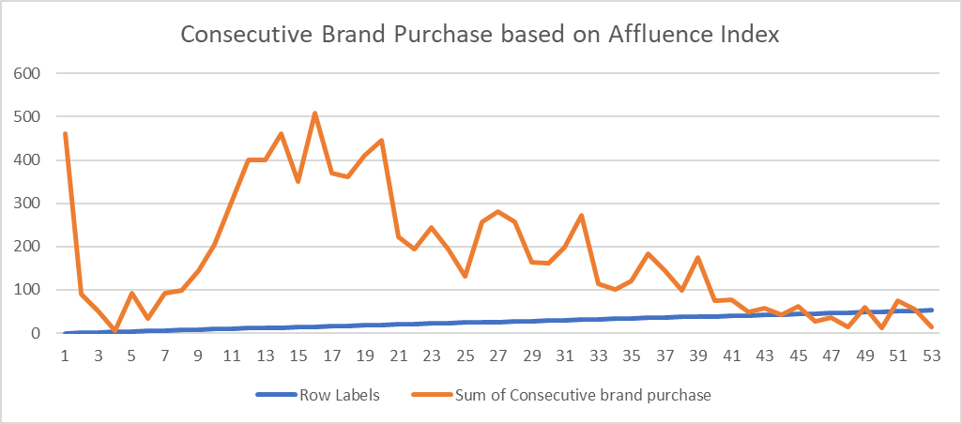
2. Results as pertaining to the project objectives
The first variable identified as part of the segmentation efforts is associated with purchase behavior. In order to assess this aspect, I have used criteria such as brand runs, total volume, the amount of transactions per brand, and then reviewed a few potential drivers against these factors.
One of the variables is the Age Group. As seen in the chart below, the most mature age group represents 50% of consecutive brand purchases.
Advertising to this group will should then enable the company to increase its sales and customer brand loyalty.
The second variable is one that describes the basis for the actual purchase.
This variable is the Affluence Index. As seen in the chart below, consecutive brand purchases (which means that customers are loyal to the brand and returning to replenish) depend on the Affluence Index.
This data does not take into consideration the effects of promotions, and is a good indicator of the financial situation of consumers who make repeat purchases.
Consumer loyalty indeed seems to be the highest between 11-19 Affluence Index, which may correspond to Middle Class.

Slide 4
2. Results as pertaining to the project objectives (cont’d)
Another variable identified with regards to customer segments is the SEX of the customer.
0 is for children, 1 for male and 2 for female.
The below table shows that Females are most likely to become loyal to a brand.
Therefore, females should represent a segment for advertisers.

Slide 5
Conclusion
The data analysis of the households consumption habits with regards to brands is mostly attributed to these variables:
1. AGE
2. AFFLUENCE INDEX
3. SEX
Instead of segmenting customers and advertise to them based on behavior and basis for purchase, CRISA should focus on the root cause of brand loyalty and therefore advertise to their customers as appropriate based on age group, wealth level and sex.
From the analysis, the customer segment with the highest brand loyalty are more mature individuals with a middle-class social status and females seem to outnumber Males when it comes to brand loyalty. Therefore the advertising budget would most effectively target this market segment.

